Slide 1

API Testing
Manual/Automation
By:
-Abdallah Albanna
-Moaz Metawea
-Mahmoud yehia

Slide 2
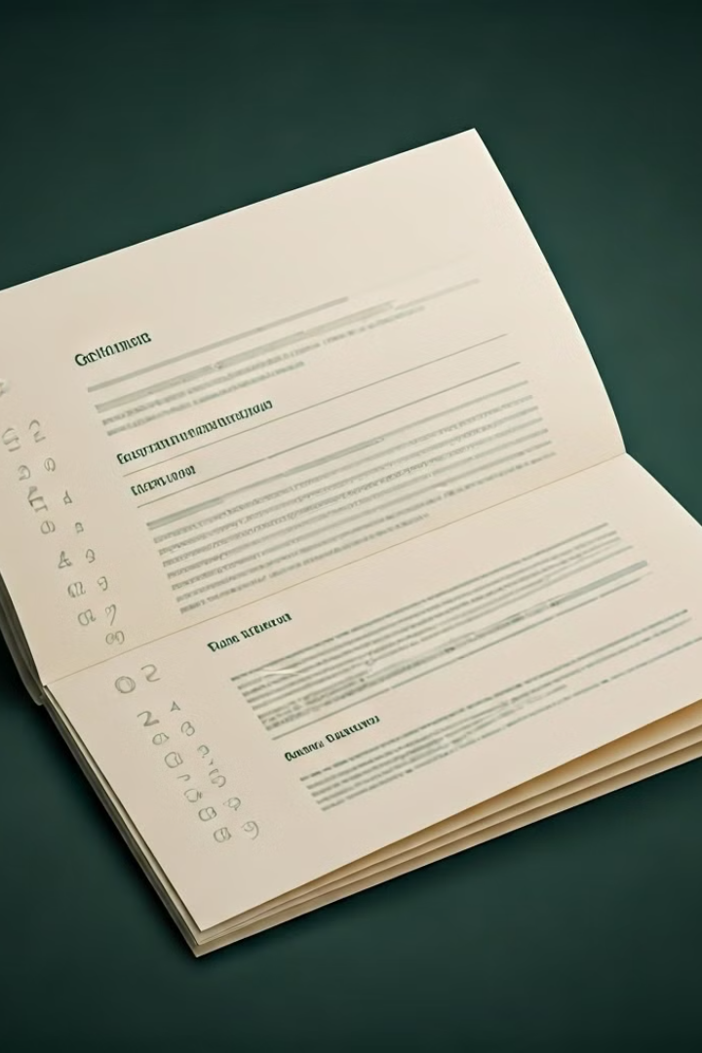
Table of Content
1
What is an API / Web Service
2
What is API Testing
3
Manual API Testing
4
API Automation

Slide 3
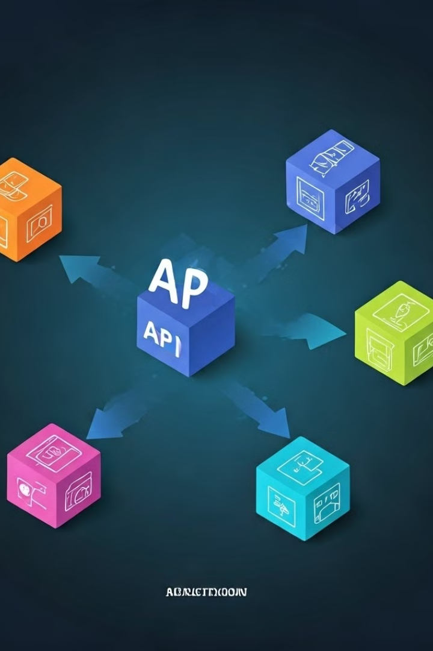
What is an API
API stands for Application Programming Interface.
A software intermediary that allows two applications to talk to each other.
APIs are an accessible way to extract and share data within and across organizations.

Slide 4

API and Web Services
Web Service
API
A collection of open source protocols and standards used for exchanging data between systems or applications
A software interface that allows two applications to interact with each other without any user involvement
All Web services are APIs, but all APIs are not web services.

Slide 5

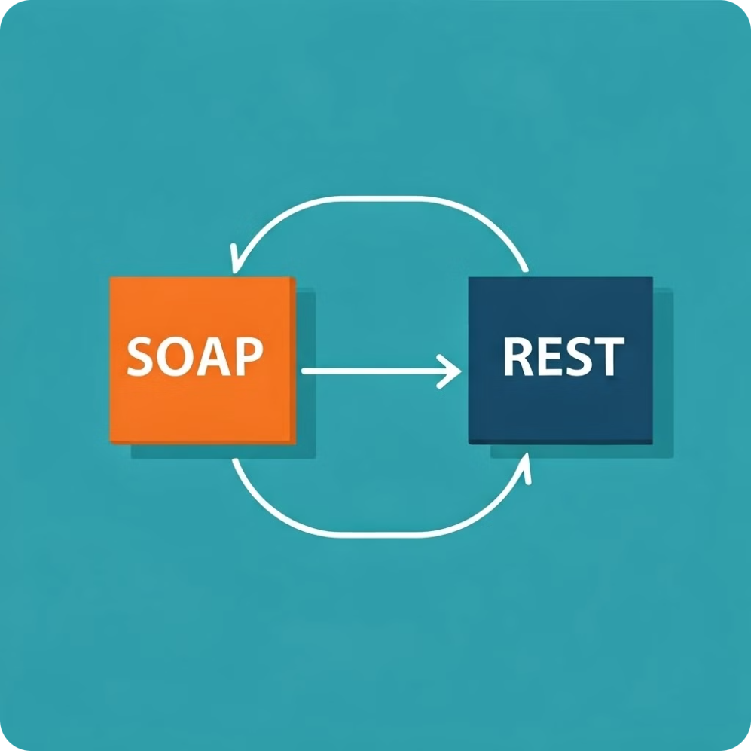
Types of Web Services
Web Service Type
Data Transfer Method
SOAP
XML
RESTful
JSON

Slide 6

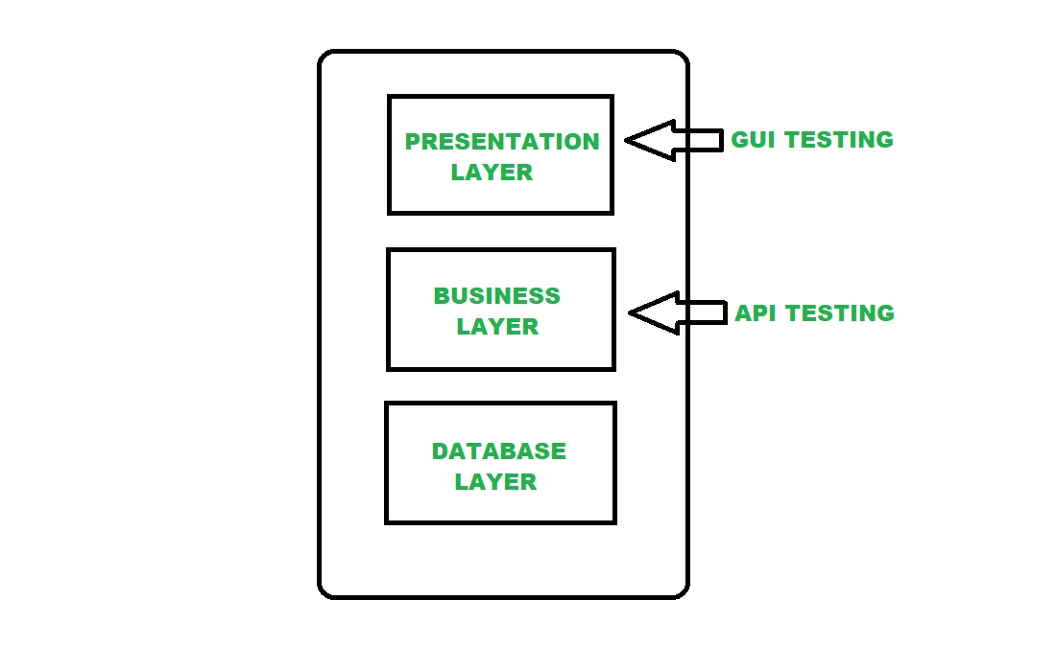
What is API Testing
1
Focus
API testing primarily focuses on testing individual API methods and their interactions.
2
Integration Level
This type of testing is generally conducted at the integration level.
3
Purpose
To ensure the functionality, reliability, and security of APIs.

Slide 7





Key Components of API Testing
Request and Response
Endpoints
Testing the flow of data between the API and the client, verifying the correctness of requests and responses.
Validating the functionality and accessibility of specific API endpoints.
Authentication
Data Formats
Ensuring secure API access and data protection through authentication mechanisms.
Verifying that data is transmitted and processed correctly in the designated formats (JSON, XML).

Slide 8





Why API Testing is Crucial
Ensuring Functionality
Ensuring that APIs operate as intended, meeting their defined specifications.
Early Bug Detection
Identifying and addressing issues early in the development cycle, minimizing potential downstream problems.
Security
Protecting sensitive data and preventing unauthorized access to API resources.
Performance
Optimizing API performance for speed, efficiency, and responsiveness.

Slide 9

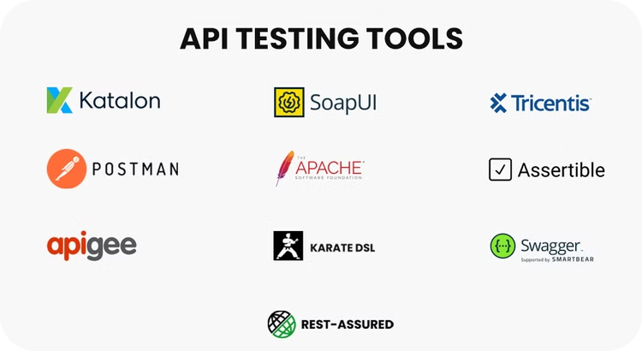
API Testing Tools
A wide array of tools can be used for API testing, each offering unique features and functionalities.

Slide 10

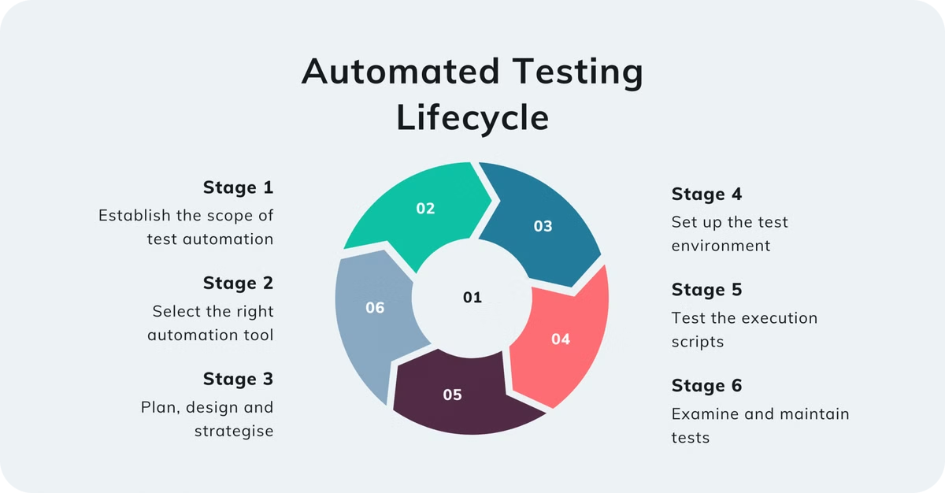
Automation Testing Life Cycle

Slide 11
API Testing Automation Project
This project involves testing the Platzi Fake API using various tools and technologies including Postman, Newman, Jenkins, and RestAssured. The purpose is to automate the testing of API endpoints to ensure their reliability and performance.

Slide 12
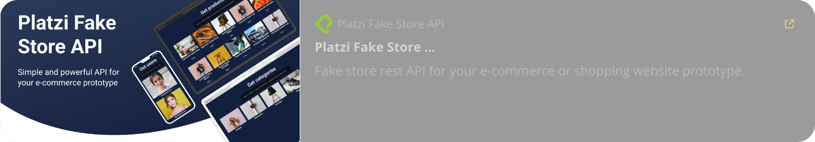
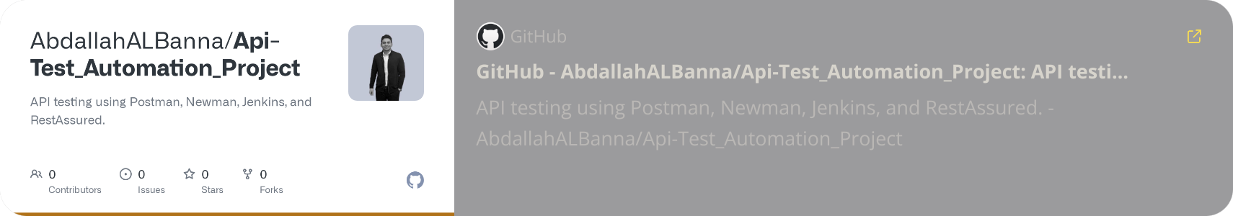
API Manual/Automation project
Demo URL:
GitHub Repository:

Slide 13


Project Scope
Postman
Rest Assured
A popular API testing platform with intuitive features and a user-friendly interface.
A Java-based API testing library known for its comprehensive capabilities and flexibility.

Slide 14
Tools & Technologiest
Postman: Used for manual API testing, sending requests, and verifying responses.
Newman: Command-line tool to run Postman collections for API testing automation.
Jenkins: Continuous Integration (CI) server to automatically run API tests on code commits or at scheduled intervals.
RestAssured: Java library for automated testing of REST APIs.

Slide 15

Project Demo

Slide 16


Q & A

Slide 17

Thank You

